Slide 1

RISC V Datapath I

Slide 2
Building a RISC-V Processor
Building a RISC-V Processor
CPU Elements and Stages
R-Type: add datapath
R-Type: sub datapath
Datapath with immediates: addi

Slide 3

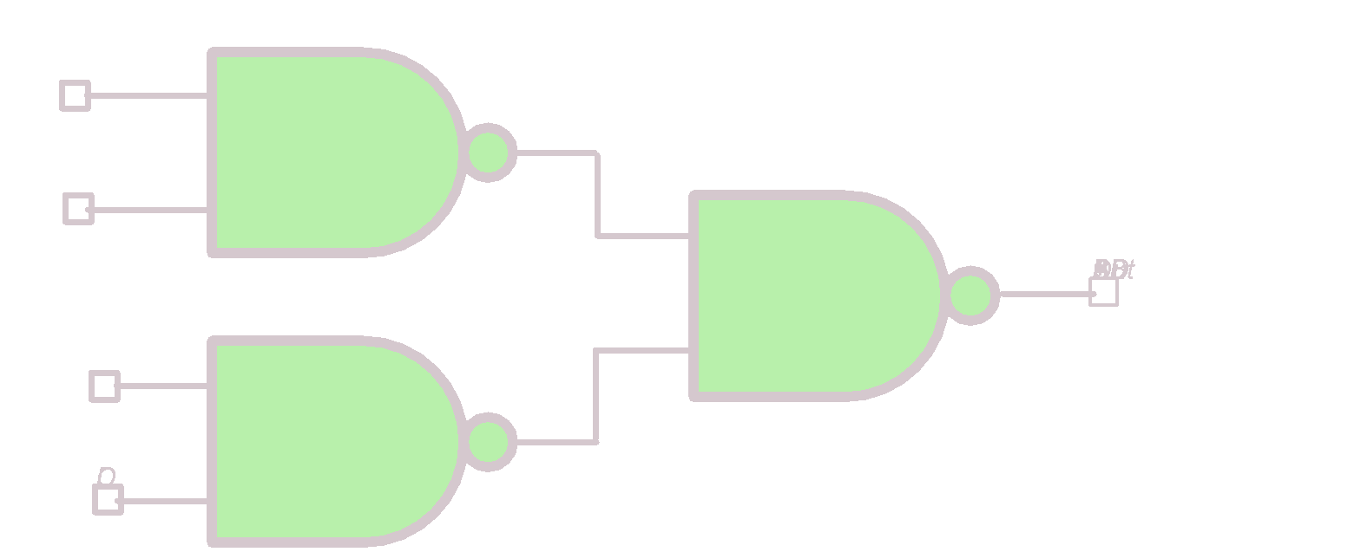
Great Idea #1: Abstraction (Levels of Representation/Interpretation)
High Level Language Program (e.g., C)
temp = v[k];
v[k] = v[k+1];
v[k+1] = temp;
Compiler
Assembly Language Program (e.g., RISC-V)
lw x3, 0(x10)
lw x4, 4(x10)
sw x4, 0(x10)
sw x3, 4(x10)
Assembler
1000 1101 1110 0010 0000 0000 0000 0000
1000 1110 0001 0000 0000 0000 0000 0100
1010 1110 0001 0010 0000 0000 0000 0000
1010 1101 1110 0010 0000 0000 0000 0100
Machine Language Program (RISC-V)
Hardware Architecture Description (e.g., block diagrams)
+4
Reg
[]
pc
pc+4
1
wb
DataD
Reg
[rs1]
1
ALU
alu
2
alu
0
pc
IMEM
inst
[11:7]
AddrD
Reg
[rs2]
0
Addr
DMEM
1
wb
pc+4
inst
[19:15]
AddrA
DataA
Branch
0
DataW
DataR
mem
0
Architecture Implementation
inst
[24:20]
AddrB
DataB
Comp.
1
Logic Circuit Description (Circuit Schematic Diagrams)
inst
[31:7]
Imm
.
imm
[31:0]
Gen

Slide 4
Old-school Machine Structures
Application (ex: browser)
Operating
System
(Mac OSX)
Compiler
Software
Assembler
Instruction Set
Architecture
Hardware
Processor
Memory
I/O system
Datapath & Control
CS61C
Digital Design
Circuit Design
Transistors
Fabrication

Slide 5


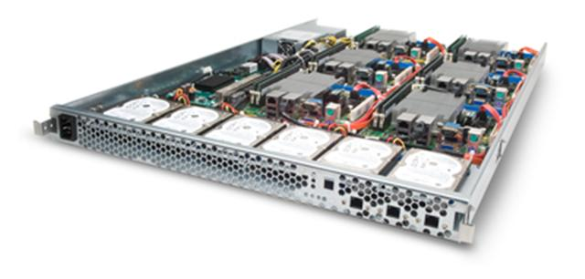
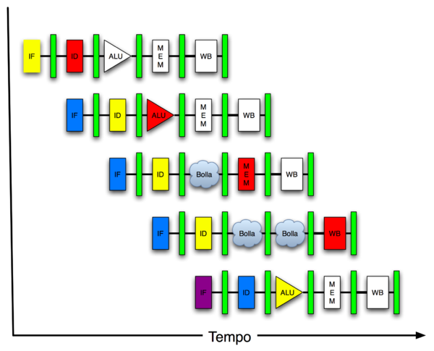
New-school Machine Structures
Software
Parallel Requests
Assigned to computer
e.g., Search “Cats”
Parallel Threads
Assigned to core e.g., Lookup, Ads
Parallel Instructions
>1 instruction @ one time
e.g., 5 pipelined instructions
Parallel Data >1 data item @ one time
e.g., Add of 4 pairs of words
Hardware descriptions All gates work in parallel at same time
Harness Parallelism &
Achieve High Performance
Hardware
Warehouse Scale Computer
Smart Phone
Computer
Core
Core
Memory (Cache)
…
Input/Output
Exec. Unit(s)
Functional
Block(s)
A₀+B₀
A₁+B₁
Main Memory
Logic Gates

Slide 6
How do we build a Single-Core Processor?
Processor (CPU): the active part of the computer that does all the work (data manipulation and decision-making).
Datapath (“the brawn”): portion of the processor that contains hardware necessary to perform operations required by the processor.
Control (“the brain”): portion of the processor (also in hardware) that tells the datapath what needs to be done.
Notes:
Apple M1 Chip is 3.1 GHz max clock rate
7/10 nm transistor density
FOR NEXT TIME: switch control and datapath descriptions to match visual layout

Slide 7

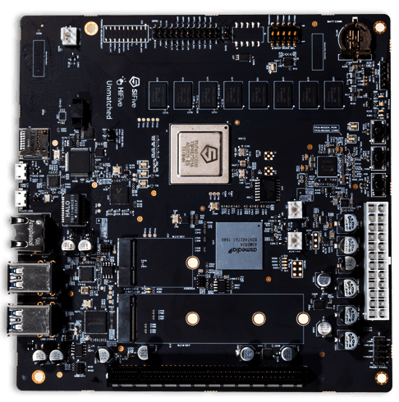
Goal: Design HW to Execute All RV32I Instructions
Open Reference Card
Base Integer Instructions: RV32I
Category Name | Fmt | RV32I Base | Category Name | Fmt | RV32I Base
Shifts Shift Left Logical | R | SLL rd,rs1,rs2 | Loads Load Byte | I | LB rd,rs1,imm
Shift Left Log. Imm. | I | SLLI rd,rs1,shamt | Load Halfword | I | LH rd,rs1,imm
Shift Right Logical | R | SRL rd,rs1,rs2 | Load Byte Unsigned | I | LBU rd,rs1,imm
Shift Right Log. Imm. | I | SRLI rd,rs1,shamt | Load Half Unsigned | I | LHU rd,rs1,imm
Shift Right Arithmetic | R | SRA rd,rs1,rs2 | Load Word | I | LW rd,rs1,imm
Shift Right Arith. Imm. | I | SRAI rd,rs1,shamt | Stores Store Byte | S | SB rs1,rs2,imm
Arithmetic ADD | R | ADD rd,rs1,rs2 | Store Halfword | S | SH rs1,rs2,imm
ADD Immediate | I | ADDI rd,rs1,imm | Store Word | S | SW rs1,rs2,imm
SUBtract | R | SUB rd,rs1,rs2 | Branches Branch = | B | BEQ rs1,rs2,imm
Load Upper Imm | U | LUI rd,imm | Branch ≠ | B | BNE rs1,rs2,imm
Add Upper Imm to PC | U | AUIPC rd,imm | Branch < | B | BLT rs1,rs2,imm
Logical XOR | R | XOR rd,rs1,rs2 | Branch ≥ | B | BGE rs1,rs2,imm
XOR Immediate | I | XORI rd,rs1,imm | Branch < Unsigned | B | BLTU rs1,rs2,imm
OR | R | OR rd,rs1,rs2 | Branch ≥ Unsigned | B | BGEU rs1,rs2,imm
OR Immediate | I | ORI rd,rs1,imm | Jump & Link J&L | J | JAL rd,imm
AND | R | AND rd,rs1,rs2 | Jump & Link Register | I | JALR rd,rs1,imm
AND Immediate | I | ANDI rd,rs1,imm
Compare Set < | R | SLT rd,rs1,rs2 | Synch Synch thread | I | FENCE
Set < Immediate | I | SLTI rd,rs1,imm
Set < Unsigned | R | SLTU rd,rs1,rs2 | Environment CALL | I | ECALL
Set < Imm Unsigned | I | SLTIU rd,rs1,imm | BREAK | I | EBREAK
Not in this class
HiFive Unmatched (RISC-V Linux)
https://www.sifive.com/boards/hifive-unmatched

Slide 8
CPU Elements and Stages
Building a RISC-V Processor
CPU Elements and Stages
R-Type: add datapath
R-Type: sub datapath
Datapath with immediates: addi

Slide 9
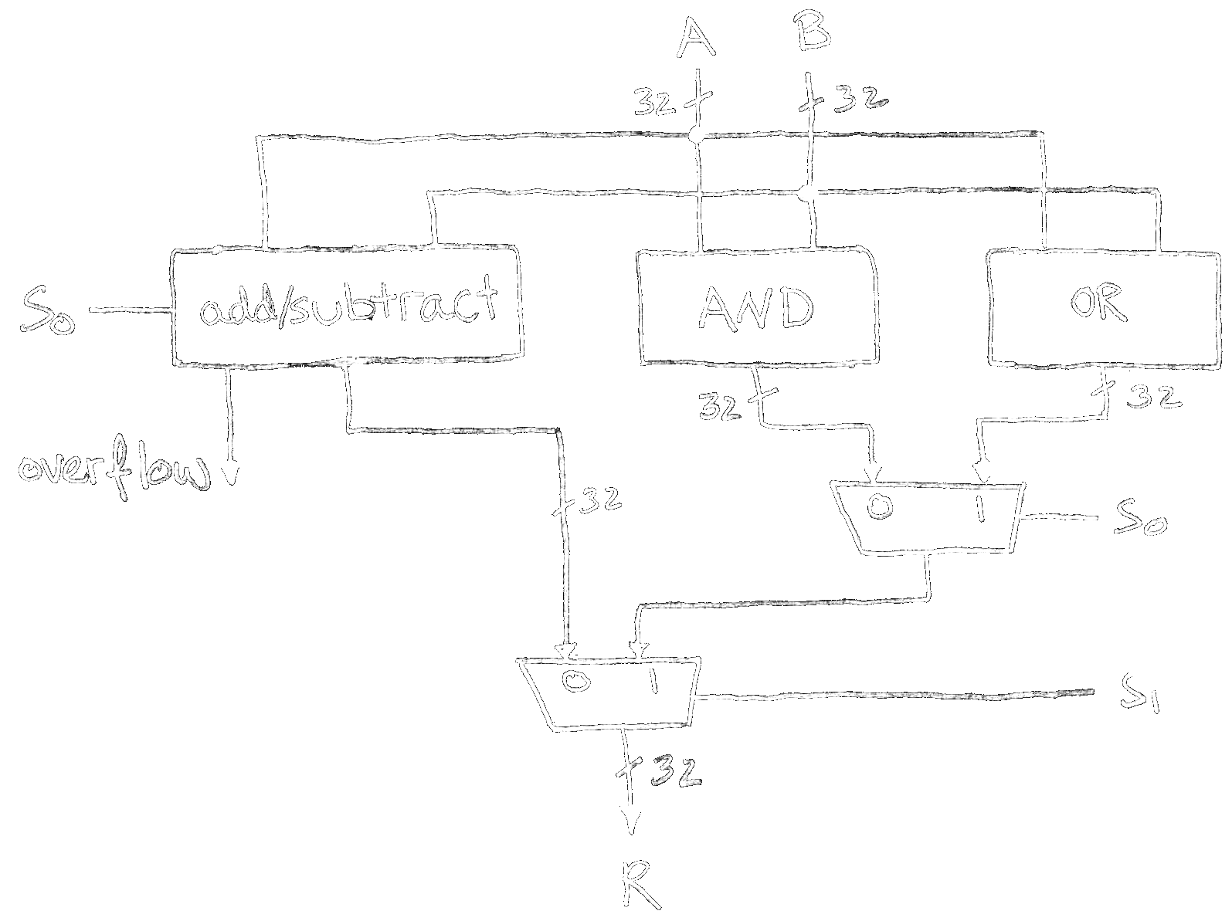
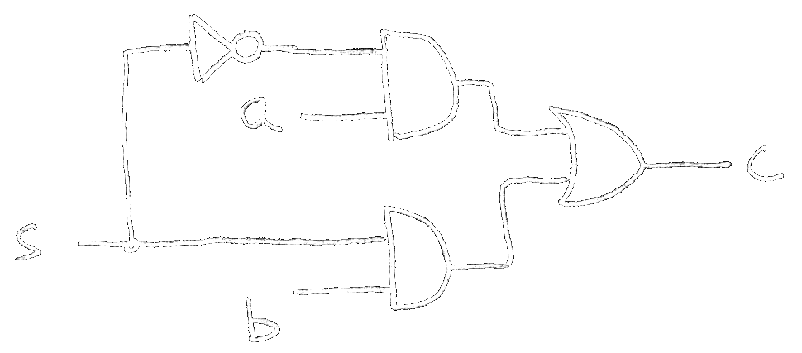
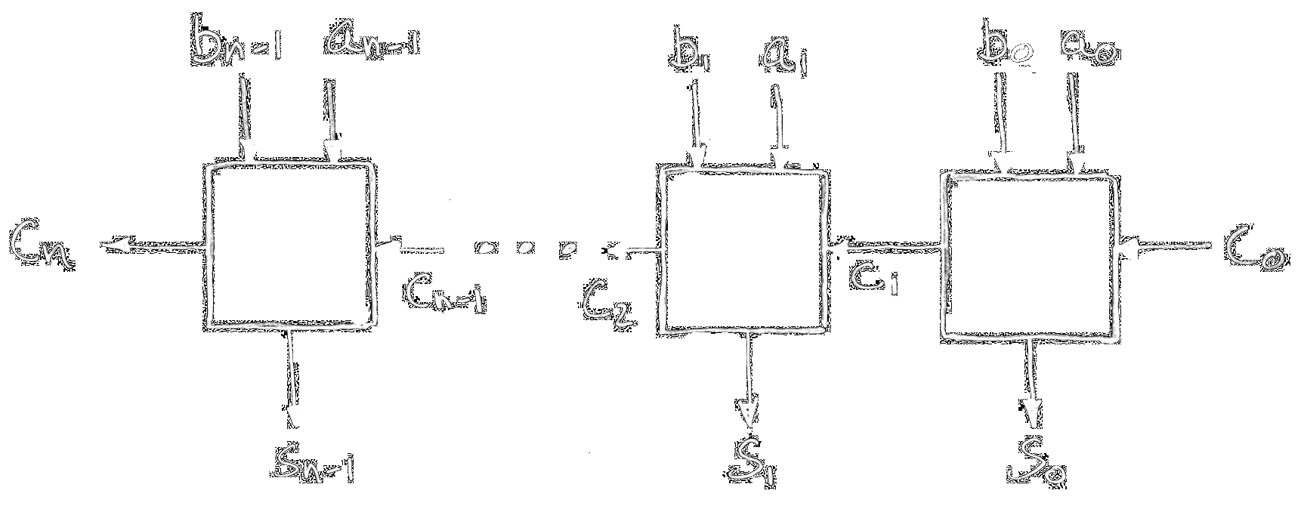
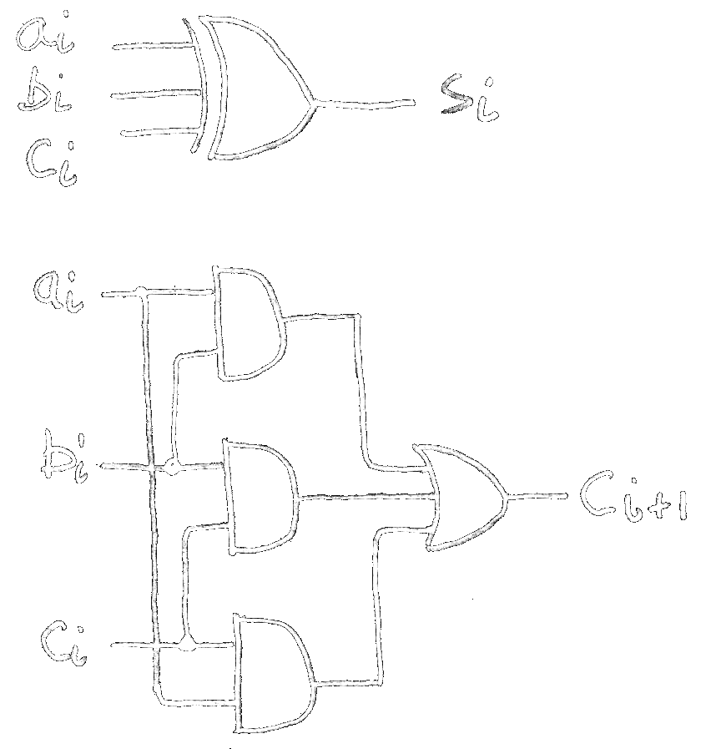
Combinational Logic Blocks
Review
Today, we will think of all combinational logic subcircuits as block diagrams:
1-bit-wide 2-to-1MUX
N-Bit Adder
Simple ALU (add,sub,and,or)
CarryIn
A
ALU
B
a
N
A
Add
B
Result
1
0
c
A
b
N
32
N
S
B
32
32
s
CarryOut
AluOp
32-bit-wide 2-to-1 MUX
32-Bit Adder
ALU (ALUOp selects from multiple operations)

Slide 10
One-Instruction-Per-Cycle RISC V Machine
The CPU is composed of two types of subcircuits: combinational logic blocks and state elements.
On every tick of the clock, the computer executes one instruction:
Current outputs of the state elements drive the inputs to combinational logic…
…whose outputs settle at the inputs to the state elements before the next rising clock edge.
At the rising clock edge:
All the state elements are updated with the combinational logic outputs…
and execution moves to the next clock cycle.
PC
IMEM
Combinational logic
Reg[ ]
DMEM
clk

Slide 11
State Elements Required by RV32I ISA
Program Counter
PC
Register File Reg
Reg[ ]
Memory MEM
IMEM
DMEM
During CPU execution, each RV32I instruction reads and/or updates these state elements.

Slide 12
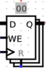
State Elements (1/3): Program Counter
Program Counter
Write Enable
PC
Data In
Data Out
The Program Counter is a 32-bit Register.
N
N
Register File Reg
A register in Logisim
Reg[ ]
clk
Input:
N-bit data input bus
Write Enable “Control” bit (1: asserted/high, 0: deasserted/0)
Output:
N-bit data output bus
Behavior:
If Write Enable is 1 on rising clock edge, set Data Out=Data In.
At all other times, Data Out will not change; it will output its current value.
Memory MEM
IMEM
DMEM

Slide 13
State Elements (2/3): Register File
Program Counter
Register File (RegFile) has 32 registers.
Input:
One 32-bit input data bus, dataW.
Three 5-bit select busses, rs1, rs2, and rsW.
RegWEn control bit.
Output:
Two 32-bit output data busses, data1 and data2.
PC
dataW
rsW
rs1 data1
rs2
data2
Reg[]
32
5
5
32
Register File Reg
Reg[ ]
5
32
RegWEn
clk
Memory MEM
Registers are accessed via their 5-bit register numbers:
R[rs1]: rs1 selects register to put on data1 bus out.
R[rs2]: rs2 selects register to put on data2 bus out.
R[rd]: rsW selects register to be written via dataW when RegWEn=1.
Clock behavior: Write operation occurs on rising clock edge.
Clock input only a factor on write!
All read operations behave like a combinational block:
If rs1, rs2 valid, then data1, data2 valid after access time.
IMEM
DMEM
RegFile behaves like a combinational block for read operations!

Slide 14
State Elements (3/3): Memory
Program Counter
dataR
addr
MEM
dataW
Memory is “magic.” For this class:
32-bit byte-addressed memory space; and
Memory access with 32-bit words.
PC
32
32
Register File Reg
32
Reg[ ]
clk
MemRW
Memory words are accessed as follows:
Read: Address addr selects word to put on dataR bus.
Write: Set MemRW=1. Address addr selects word to be written with dataW bus.
Like RegFile, clock input is only a factor on write.
If MemRW=1, write occurs on rising clock edge.
If MemRW=0 and addr valid, then dataR valid after access time.
Memory MEM
IMEM
DMEM
If MemRW=0, MEM behaves like a combinational block.
Notes:
Note: What happens with sb? (answer: only the lowest byte in the register is taken, and only that byte in memory changes). Similar for sh.

Slide 15
“Two” Memories: IMEM, DMEM
Program Counter
dataR
addr
MEM
dataW
addr
inst
IMEM
dataR
addr
DMEM
dataW
PC
32
32
32
32
32
32
Register File Reg
32
32
Reg[ ]
clk
clk
MemRW
MemRW
Current abstraction: Memory holds both instructions and data in one contiguous 32-bit memory space.
In our processor, we’ll use two “separate” memories:
IMEM: A read-only memory for fetching instructions.
DMEM: A memory for loading (read) and storing (write) data words.
Under the hood, these are placeholders for caches. (more later)
Because IMEM is read-only, it always behaves like a combinational block:
If addr valid, then instr valid after access time.
Memory MEM
IMEM
DMEM

Slide 16
Design the Datapath in Phases
Task: “Execute an instruction.”
All necessary operations, starting with fetching the instruction.
Problem: A single “monolithic” block would be bulky and inefficient.
Solution: Break up the process into stages, then connect the stages to create the whole datapath.
Smaller stages are easier to design!
Modularity: Easy to optimize one stage without touching the others.
PC
IMEM
Combinational logic
Reg[ ]
DMEM
clk
(hard to implement this block diagram as-is)

Slide 17
5 Basic Stages (Phases) of Instruction Execution
1. Instruction Fetch (IF)
2. Instruction Decode (ID)
+ Read Registers
3. Execute (EX)
Arithmetic Logic Unit (ALU)
4. Memory Access (MEM)
5. Write back to Register (WB)
IMEM
ALU
DMEM
PC
Reg[ ]
clk
We will implement a single-cycle processor:
All stages of one RV32I instruction execute within the same clock cycle.

Slide 18
Not All Instructions Need All 5 Stages!
1. Instruction Fetch (IF)
2. Instruction Decode (ID)
+ Read Registers
3. Execute (EX)
Arithmetic Logic Unit (ALU)
4. Memory Access (MEM)
5. Write back to Register (WB)
IMEM
ALU
DMEM
PC
Reg[ ]
Control Logic
The control logic selects “needed” datapath lines based on the instruction.
MUX selector, ALU op selector, write enable, etc.

Slide 19
R-Type: add Datapath
Building a RISC-V Processor
CPU Elements and Stages
R-Type: add datapath
R-Type: sub datapath
Datapath with immediates: addi

Slide 20
Implementing the add Instruction
Suppose we had a single instruction in our RISC-V ISA: add.
The add instruction makes two changes to processor state:
RegFile Reg[rd] = Reg[rs1] + Reg[rs2]
PC PC = PC + 4
Example add-only program | Assembly instructions
0x100 | add x18,x18,x10
0x108 | add x18,x18,x18
… | add …
add rd, rs1, rs2
31 |  |  |  | 25 | 24 |  | 20 | 19 |  | 15 | 14 | 12 | 11 |  | 7 | 6 |  |  |  | 0
funct7 |  |  |  |  |  |  |  |  |  |  | funct3 |  |  |  |  | opcode
0000000 |  |  |  |  | rs2 |  |  | rs1 |  |  | 000 |  | rd |  |  | 0110011
7 |  |  |  |  | 5 |  |  | 5 |  |  | 3 |  | 5 |  |  | 7
“add”
“add”
Reg-Reg opcode

Slide 21
Datapath for add
31 |  |  |  | 25 | 24 |  | 20 | 19 |  | 15 | 14 | 12 | 11 |  | 7 | 6 |  |  |  | 0
funct7 |  |  |  |  | rs2 |  |  | rs1 |  |  | funct3 |  | rd |  |  | 0110011
PC = PC + 4
R[rd] = R[rs1] + R[rs2]
Increment PC to next instruction.
Split instruction to index into RegFile.
Feed read register values into Add.
Write Add output to destination register.
+4
add
pc+4
dataW
rsW
rsR1 dataR1
rsR2
dataR2
Reg[]
PC
inst[11:7]
inst[19:15]
inst[24:20]
addr
inst
IMEM
R[rs1]
pc
A
Add
B
add
clk
R[rs2]
clk
Control Logic
RegWEn
1
Notes:
For next time: emphasize when write happens
From textbook, Figure 4.7: Remember that writes are edge-triggered, so that all the write inputs (i.e, the value to be written, the register number, and the write control signal) must be valid at the clock edge. Since writrs to the register file are edge-triggered, our design can legally writ and read the same register within a clock cycle: the read will get the value written in an earlier clock cycle, while the value written will be available to read in a subsequent clock cycle.

Slide 22
Plan: Iteratively Build Full Datapath
For now, we will disconnect memory. By the end of next lecture, we’ll build the datapath that supports the full RV32I ISA.
+4
add
pc+4
dataW
rsW
rsR1 dataR1
rsR2
dataR2
Reg[]
PC
inst[11:7]
inst[19:15]
inst[24:20]
addr
inst
IMEM
R[rs1]
pc
A
Add
B
dataR
addr
DMEM
dataW
add
clk
R[rs2]
clk
clk
Control Logic
RegWEn
1
Notes:
For next time: switch with previous slide, remove wires

Slide 23
R-Type: sub Datapath
Building a RISC-V Processor
CPU Elements and Stages
R-Type: add datapath
R-Type: sub datapath
Datapath with immediates: addi

Slide 24
Implementing the sub Instruction
What if our ISA now had two instructions: add/sub?
funct7 |  |  | funct3 |  | opcode
0000000 | rs2 | rs1 | 000 | rd | 0110011 | add
0100000 | rs2 | rs1 | 000 | rd | 0110011 | sub
sub rd, rs1, rs2
sub is almost the same as add, except now the ALU subtracts operands instead of adding them:
RegFile Reg[rd] = Reg[rs1] - Reg[rs2]
PC PC = PC + 4
Instruction bit inst[30] selects between add/sub.
Details left to control logic.

Slide 25
Datapath for sub
31 |  |  |  | 25 | 24 |  | 20 | 19 |  | 15 | 14 | 12 | 11 |  | 7 | 6 |  |  |  | 0
0100000 |  |  |  |  | rs2 |  |  | rs1 |  |  | funct3 |  | rd |  |  | 0110011
PC = PC + 4
R[rd] = R[rs1] - R[rs2]
Increment PC to next instruction.
Split instruction to index into RegFile.
Feed read register values into ALU.
Write ALU output to destination register.
+4
add
pc+4
dataW
rsW
rsR1 dataR1
rsR2
dataR2
Reg[]
PC
inst[11:7]
inst[19:15]
inst[24:20]
addr
inst
IMEM
R[rs1]
pc
A
ALU
B
alu
clk
R[rs2]
The control line ALUSel selects which ALU operation to output.
Convention: Add(0), Sub(1).
Pass instr to Control for instruction decoding (for now, all 32 bits).
clk
ALUSel
Sub
Control Logic
inst[31:0]
RegWEn
1

Slide 26


Control vs. Datapath Analogy: Space Mission
Control and Datapath are two abstractions that together comprise the CPU. Under the hood, both are designed with combinational logic and/or state elements.
Space Station
+4
add
pc+4
dataW
rsW
rsR1 dataR1
rsR2
dataR2
Reg[]
PC
inst[11:7]
inst[19:15]
inst[24:20]
addr
inst
IMEM
R[rs1]
pc
A
ALU
B
alu
clk
R[rs2]
Mission Control
“Control, what should I do? Here’s the instruction.”
“RegFile, enable register write.”
clk
“ALU, perform Sub op.”
ALUSel
Sub
Control Logic
inst[31:0]
RegWEn
1

Slide 27
Supporting all R-Type Instructions
funct7 |  |  | funct3 |  | opcode
0000000 | rs2 | rs1 | 000 | rd | 0110011 | add
0100000 | rs2 | rs1 | 000 | rd | 0110011 | sub
0000000 | rs2 | rs1 | 001 | rd | 0110011 | sll
0000000 | rs2 | rs1 | 010 | rd | 0110011 | slt
0000000 | rs2 | rs1 | 011 | rd | 0110011 | sltu
0000000 | rs2 | rs1 | 100 | rd | 0110011 | xor
0000000 | rs2 | rs1 | 101 | rd | 0110011 | srl
0100000 | rs2 | rs1 | 101 | rd | 0110011 | sra
0000000 | rs2 | rs1 | 110 | rd | 0110011 | or
0000000 | rs2 | rs1 | 111 | rd | 0110011 | and
A
ALU
B
The Control Logic decodes funct3, funct7 instruction fields and selects appropriate ALU function by setting the control line ALUSel.
ALUSel
add,sub,xor,and,or,slt,sltu,sll,sra,srl
Check out Project 3 for the full ALU!
Notes:
rd = (rs1 < rs2) ? 1 : 0

Slide 28
Datapath with Immediates: addi
Building a RISC-V Processor
CPU Elements and Stages
R-Type: add datapath
R-Type: sub datapath
Datapath with immediates: addi

Slide 29
Implementing the addi Instruction
Suppose we add a new instruction: addi, RV32I I-Format:
The addi instruction updates the same two states as before. But we now need to build an immediate imm!
RegFile Reg[rd] = Reg[rs1] + imm
PC PC = PC + 4
addi rd, rs1, imm
31 |  |  |  | 25 | 24 |  | 20 | 19 |  | 15 | 14 | 12 | 11 |  | 7 | 6 |  |  |  | 0
 |  |  |  |  |  |  |  |  |  |  | funct3 |  |  |  |  | opcode
imm[11:0] |  |  |  |  |  |  |  | rs1 |  |  | 000 |  | rd |  |  | 0010011
12 |  |  |  |  |  |  |  | 5 |  |  | 3 |  | 5 |  |  | 7
“add”
OP-IMM

Slide 30
What Does the Datapath Need for addi?
PC = PC + 4
R[rd] = R[rs1] + imm
To compute alu = R[rs1] + imm…
✅
…we should feed in an immediate to ALU input B (instead of R[rs2]).
+4
add
pc+4
dataW
rsW
rsR1 dataR1
rsR2
dataR2
Reg[]
PC
inst[11:7]
inst[19:15]
inst[24:20]
addr
inst
IMEM
R[rs1]
pc
A
ALU
B
alu
clk
R[rs2]
clk
ALUSel
Add
Control Logic
inst[31:0]
RegWEn
1

Slide 31
1. New MUX to Select Immediate for ALU
1. Control line Bsel=1 selects the generated immediate imm for ALU input B.
+4
add
pc+4
dataW
rsW
rsR1 dataR1
rsR2
dataR2
Reg[]
PC
inst[11:7]
inst[19:15]
inst[24:20]
addr
inst
IMEM
R[rs1]
pc
A
ALU
B
alu
clk
R[rs2]
0
1
clk
imm
Bsel
1
ALUSel
Add
Control Logic
inst[31:0]
RegWEn
1

Slide 32
2. New Block to Generate 32-bit Immediate
2. Immediate Generation Block builds a 32-bit immediate imm from instruction bits.
1. Control line Bsel=1 selects the generated immediate imm for ALU input B.
+4
add
pc+4
dataW
rsW
rsR1 dataR1
rsR2
dataR2
Reg[]
PC
inst[11:7]
inst[19:15]
inst[24:20]
addr
inst
IMEM
R[rs1]
pc
A
ALU
B
alu
clk
R[rs2]
0
1
Split and get the upper 12 bits of instr.
inst[31:20]
Imm. Gen
clk
imm[31:0]
Bsel
1
ALUSel
Add
Control Logic
inst[31:0]
ImmSel
I
RegWEn
1

Slide 33
Tracing/Lighting the addi Datapath
Increment PC to next instruction.
Immediate Generation Block builds a 32-bit immediate imm from instruction bits.
Control line Bsel=1 selects the generated immediate imm for ALU input B.
Write ALU output to destination register.
+4
add
pc+4
dataW
rsW
rsR1 dataR1
rsR2
dataR2
Reg[]
PC
inst[11:7]
inst[19:15]
inst[24:20]
addr
inst
IMEM
R[rs1]
pc
A
ALU
B
pc
alu
clk
R[rs2]
0
1
Imm. Gen
clk
inst[31:20]
Imm. Gen
R[rs2]
imm[31:0]
Bsel
Bsel
1
ALUSel
ALUSel
Add
Control Logic
ImmSel
ImmSel
I
RegWEn
inst[31:0]
RegWEn
1
Data inst[24:20] still feeds into Reg[], which still outputs R[rs2].
However, control Bsel=1 means R[rs2] data line is ignored.

Slide 34
Immediate Generation Block Design
(more next time)
Instruction inst[31:0]
inst[31:20]
Imm. Gen
imm[31:0]
31 | 30 |  |  |  |  |  | 20 | 19 |  | 15 | 14 | 12 | 11 |  | 7 | 6 |  |  |  | 0
imm[11:0] | imm[10:0] |  |  |  |  |  |  | rs1 |  |  | funct3 |  | rd |  |  | opcode
s | ... .... ....
Copy upper 12 bits of instruction, inst[31:20], to lower 12 bits of immediate, imm[11:0].
Immediate imm[31:0]
Sign-extend: Copy inst[31] to upper 20 bits of immediate, imm[31:12].
31 |  |  |  |  |  |  |  |  |  |  |  | 12 | 11 |  |  |  |  |  |  | 0
imm[31:12] |  |  |  |  |  |  |  |  |  |  |  |  | imm[11:0]
ssss ssss ssss ssss ssss |  |  |  |  |  |  |  |  |  |  |  |  | s... .... ....

Slide 35
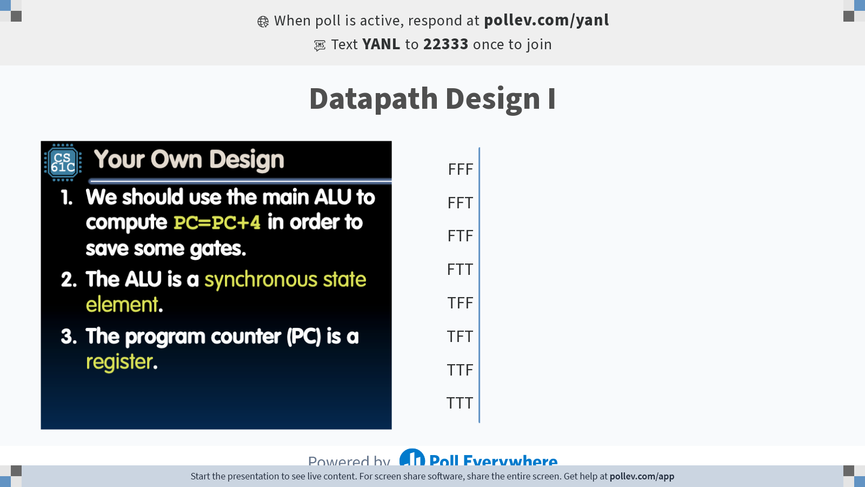
Notes:
Do not modify the notes in this section to avoid tampering with the Poll Everywhere activity. More info at polleverywhere.com/support Datapath Design I
https://www.polleverywhere.com/multiple_choice_polls/iSgOoVAN9UVbGcYUiWrbY?state=opened&flow=Default&onscreen=persist

Slide 36
Your Own Design
We should use the main ALU to compute PC=PC+4 in order to save some gates.
The ALU is a synchronous state element.
The program counter (PC) is a register.
123
FFF
FFT
FTF
FTT
TFF
TFT
TTF
TTT

Slide 37
Summary: Arithmetic/Logical Datapath
All data lines carry information.
Control logic determines what is “useful/needed” vs. what is “ignored.”
e.g., ALUSel: chooses ALU operation; Bsel: chooses register/immediate for ALU input B.
+4
add
pc+4
dataW
rsW
rsR1 dataR1
rsR2
dataR2
Reg[]
PC
inst[11:7]
inst[19:15]
inst[24:20]
addr
inst
IMEM
R[rs1]
pc
A
ALU
B
pc
alu
clk
R[rs2]
0
1
Imm. Gen
clk
inst[31:20]
Imm. Gen
R[rs2]
imm[31:0]
Bsel
0: R[rs1]
1: imm
ALUSel
add,sub,xor,and,or,
slt,sltu,sll,sra,srl
Control Logic
inst[31:0]
ImmSel
I: I-Type
(more next time)
RegWEn
1

Slide 38
Our Single-Core Processor So Far…
P
r
o
c
e
s
sor
Memo
r
y
Enabl
e
?
I
n
put
C
on
t
r
ol
R
ead
/
W
r
i
t
e
P
r
o
g
r
am
A
dd
r
e
s
s
D
a
t
ap
at
h
P
r
o
g
r
am
C
oun
t
er (PC)
B
y
t
e
s
R
egi
s
t
e
r
s
W
r
i
t
e
D
a
t
a
D
a
t
a
R
ead
D
a
t
a
A
r
i
t
hm
e
t
i
c
-Logic
Ou
t
put
U
nit
(
A
L
U)

